Slide 1
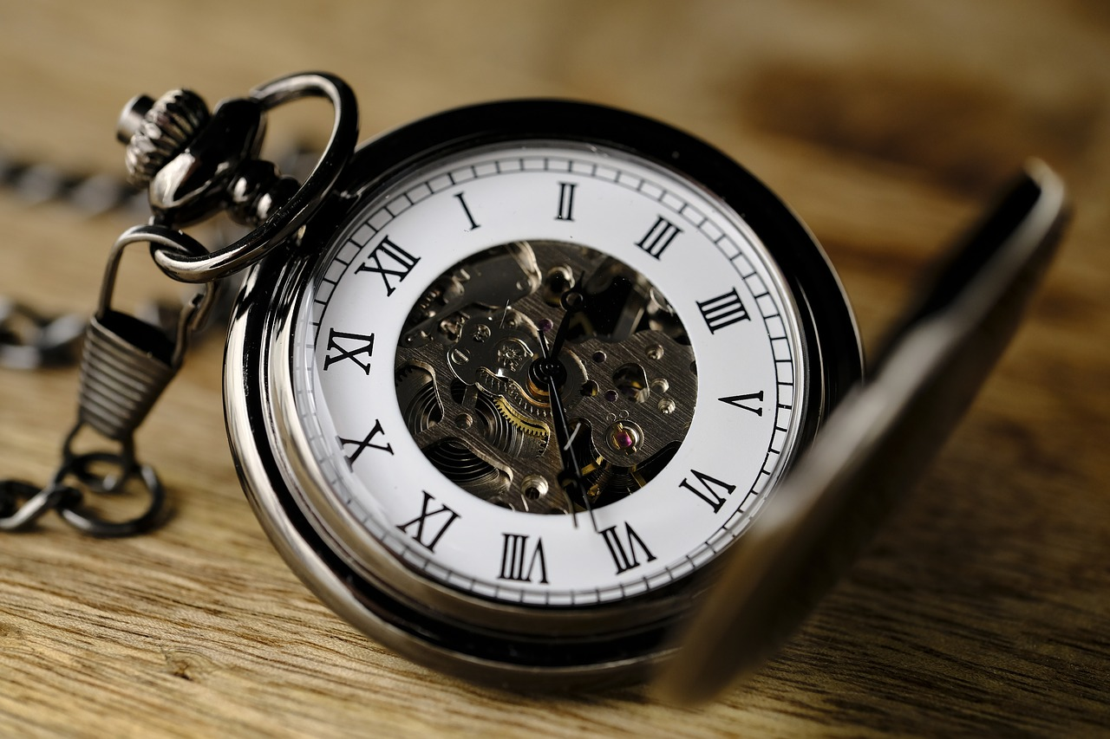



FINM542: Corporate Finance - 1
Time Value of Money

Slide 2
Learning outcome
Familiarity with money multiplication
Practical exposure of discounting and compounding
Identify right investment option for wealth creation

Slide 3
Current news
https://bfsi.economictimes.indiatimes.com/news/banking/smaller-banks-follow-big-peers-hike-fd-rates/93719028
https://bfsi.economictimes.indiatimes.com/news/banking/idbi-bank-increases-retail-term-deposit-rates-to-6-70/93707224

Slide 4
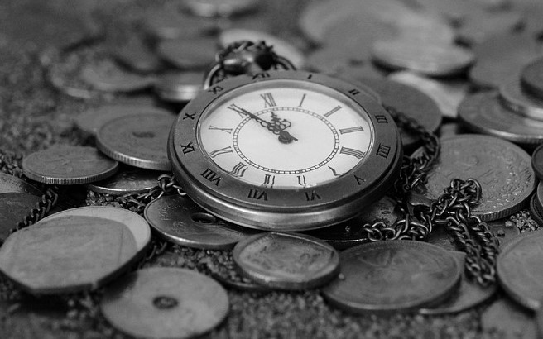
1
Time Value of Money
Time Value of Money states that money today is more valuable than money tomorrow or in future, i.e., money losses its value (Purchasing Power) with passage of time.

Slide 5
2
Why Money has Time Value?
It can be used for transaction purpose
It can be used for speculation
It serves as a store of value
Future encompasses risk so people want risk premium

Slide 6
3
Why Money has Time Value?
Since future is uncertain, people want compensation for parting with their money at present. They want a compensation for:
Lost Opportunities (Opportunity Cost)
Taking Risk (Risk Premium)

Slide 7
4
How to visualize Time Value of Money?
Present
Future
=
Money at present + Some Compensation in FUTURE
Money at present

Slide 8
5
Interest
It is the compensation received for parting with money. It represents to time value of money and known as expected return/ cut off rate.
Interest can be simple interest or compound interest.

Slide 9
6
Interest
Simple Interest:
When interest is given only on the PRINCIPAL amount, the interest so earned is termed as Simple Interest
In financial transactions only compound interest is considered
Compound Interest:
A situation where, interest is earned on the PRINCIPAL amount as well as on the ACCRUED INTEREST, i.e., interest on interest; such interest is termed as Compound Interest

Slide 10
7
Compounding vs. Discounting
Compounding:
Technique of converting PRESENT VALUE into FUTURE VALUE where visibly money in hand in Future > money in hand at Present. However, value of money in future is less than value of money at present
Value = Purchasing Power
Discounting:
Technique of converting FUTURE VALUE into PRESENT VALUE where visibly money in hand at Present < money in hand in Future. However, value of money at present is more than value of money in future.

Slide 11
8
Use of Compounding & Discounting
Technique of Compounding is used for the calculation of Future Value, Future Value of Annuity
Technique of Discounting is used for the calculation of Present Value, Present Value of Annuity

Slide 12
9
What is meant by frequency of compounding
Compounding is done to incorporate effect of interest earned on interest. Frequency of compounding states that number of times investment and the interest thereon will fetch interest in a year. A compounding frequency may vary as:
Annual
Monthly
Half-Yearly
Daily
Quarterly
Continuously

Slide 13
10
Annual Compounding (example)
Ravi deposited Rs. 10,000 in bank today @ 20% p.a. compounded annually. How much amount he will get after two years.
Principal remained invested for 2 years
Interest remained invested for 1 year
Total Amount = 10,000+2000+2400 = 14,400
0
1
2
Additional 400 (out of 2400) is the effect of compounding
10,000*20%*1 = 2,000
(10,000+2000)*20%*1 = 2,400
Interest for 1st year
Interest for 2nd year, i.e., interest on principal + interest on interest

Slide 14
11
Less Than Annual Compounding (example)
Ravi deposited Rs. 10,000 in bank today @ 20% p.a. compounded quarterly. How much amount he will get after two years.
1Y
2Y
0
1
2
3
4
5
6
7
8
Int. for 1st Qtr.
Int. for 2nd Qtr.
Int. for 3rd Qtr.
Int. for 4th Qtr.
Int. for 5th Qtr.
Int. for 6th Qtr.
Int. for 7th Qtr.
Int. for 8th Qtr.

Slide 15
12
Less Than Annual Compounding (example)
1Y
2Y
0
1
2
3
4
5
6
7
8
Int. for 1st Qtr.
Int. for 2nd Qtr.
Int. for 3rd Qtr.
Int. for 4th Qtr.
Int. for 5th Qtr.
Int. for 6th Qtr.
Int. for 7th Qtr.
Int. for 8th Qtr.
10,000*20%*3/12 = 500
10,500*20%*3/12 = 525
11,025*20%*3/12 = 551.25
11,576.25*20%*3/12 = 578.81
12,155.06*20%*3/12 = 607.75
12,762.81*20%*3/12 = 638.14
13400.95*20%*3/12 = 670.04
14,070.99*20%*3/12 = 703.55
Total Interest = 4774.54; Total Amount = 14,774.54

Slide 16
13
Effective Rate of Interest
The rate of interest which equates less than annual compounding with annual compounding is called Effective Rate of Interest.
It represents to real return on an investment when effect of compounding is incorporated.

Slide 17
14
Effective Rate of Interest
One can calculate effective rate of Interest using the formula:
Where ‘m’ represents to frequency of compounding in a year and n =1
+ r ^{nm} - 1
m
1
Multiply the result with 100 to get the value in percentage

Slide 18
15
Effective Rate of Interest (example)
Ms. Priya wants to invest some amount. She enquires about the prevailing rate of interest in the market and finds that Axis Bank is giving 10% interest p.a. compounded Annually; where as IDBI Bank quoted 10% p.a. compounded Half Yearly, Kotak Bank offers 10% p.a. compounded Quarterly; SBI gives 10% p.a. compounded Monthly, IDFC pays 10% p.a. compounded daily and PNB pays 10% p.a. compounded continuously. Now Priya is utterly confused as she is not financially literate. So, she seeks your help. She wants to invest with the bank where her returns will be maximized.

Slide 19
16
Effective Rate of Interest (example)
Axis Bank
IDBI Bank
Kotak Bank
10% compounded annually
10% compounded half-yearly
10% compounded quarterly
Here, m=1; n=1
Where ‘m’ represents to frequency of compounding in one year
Here, m=2; n=1
Where ‘m’ represents to frequency of compounding in one year
Here, m=4; n=1
Where ‘m’ represents to frequency of compounding in one year
[(1+0.10/1)^1*1] – 1
1.10 – 1
= 0.10
=10% p.a. compounded annually
[(1+0.10/2)^1*2] – 1
1.1025 – 1
= 0.1025
=10.25% p.a. compounded annually
[(1+0.10/4)^1*4] – 1
1.1038 – 1
= 0.1038
=10.38% p.a. compounded annually

Slide 20
17
Effective Rate of Interest (example)
SBI Bank
IDFC Bank
PNB Bank
10% compounded monthly
10% compounded daily
10% compounded continuously
Here, m=12; n=1
Where ‘m’ represents to frequency of compounding in one year
Here, m=365; n=1
Where ‘m’ represents to frequency of compounding in one year
Here, m=∞; n=1
Where ‘m’ represents to frequency of compounding in one year
[(1+0.10/12)^1*12] – 1
1.1047 – 1
= 0.1047
=10.47% p.a. compounded annually
[(1+0.10/365)^1*365] – 1
1.1051 – 1
= 0.1051
=10.51% p.a. compounded annually
e^{rn} – 1
Where e = exponent and its value is always equal to 2.7182
= (2.7182^0.10*1) – 1
=1.1052-1
= 0.1052
=10.52% p.a. compounded annually

Slide 21
18
Effective Rate of Interest (example)
Axis Bank
IDBI Bank
Kotak Bank
10% p.a. Compounded Annually
10.25% p.a. Compounded Annually
10.38% p.a. Compounded Annually
SBI Bank
IDFC Bank
PNB Bank
10.47% p.a. Compounded Annually
10.51% p.a. Compounded Annually
10.52% p.a. Compounded Annually
Winner

Slide 22
19
Timeline, Present & Future Value
Value of money today (at the beginning of year is called PRESENT VALUE (PV)
Value of money on a future date (at the end of year is called FUTURE VALUE (PV)
PV
FV
0
1
Timeline

Slide 23
20
Future Value of Money
Future Value is the amount of money that will grow over a period with simple or compounded interest, i.e. It is the Present Value of Money plus opportunity cost of money and the risk premium.

Slide 24
21
Future Value of Money
Future Value (FV) may be calculated as:
FV = PV (1 + r)^{n}
Where,
PV = Present Value of Money
r = Rate of interest p.a.
n = time for which money is deposited
m = Frequency of compounding in one year
(1+r)^{n} = Future Value Interest Factor (FVIF _{r, n})

Slide 25
22
Future Value of Money
Future Value (FV) for compounding of less than annual frequency may be calculated as:
FV = PV r ^{nm}
1 +
m
Where,
PV = Present Value of Money
r = Rate of interest p.a.
n = time for which money is deposited

Slide 26
23
Future Value of Money (example)
What is the future value of Rs. 20,000 invested now for a period of 5 years at an interest rate of 8% p.a. compounded annually?

Slide 27
23
Future Value of Money (example)
What is the future value of Rs. 20,000 invested now for a period of 5 years at an interest rate of 8% p.a. compounded annually?
20,000 (1+0.08)^5 = Rs. 29,386

Slide 28
24
Future Value of Money (example)
What is the future value of Rs. 20,000 invested now for a period of 5 years at an interest rate of 8% p.a. compounded quarterly?

Slide 29
24
Future Value of Money (example)
What is the future value of Rs. 20,000 invested now for a period of 5 years at an interest rate of 8% p.a. compounded quarterly?
5*4
5*4
0.08
20,000
1 +
0.08
FV =
4
4
= Rs. 29,718

Slide 30
25
Present Value of Money
Present value is the concept that states an amount of money today is worth more than that same amount in the future. In other words, money received in the future is not worth as much as an equal amount received today.

Slide 31
26
Present Value of Money
Present Value (PV) may be calculated as:
1
PV = FV*
(1 + r)^{n}
Where,
FV = Future Value of Money
r = Rate of interest p.a.
n = Time for which money is deposited
1/(1+r)^n = PVIF _{r, n}

Slide 32
27
Present Value of Money
Present Value (PV) for compounding of less than annual frequency may be calculated as:
1
PV = FV*
1 + r ^{nm}
m
Where,
PV = Present Value of Money
r = Rate of interest p.a.
n = time for which money is deposited
m = Frequency of compounding in one year

Slide 33
28
Present Value of Money (example)
What is the present value of Rs. 29,386 received after 5 years at an interest rate of 8% p.a. compounded annually?

Slide 34
28
Present Value of Money (example)
What is the present value of Rs. 29,386 received after 5 years at an interest rate of 8% p.a. compounded annually?
1
PV = 29,386*
(1 + .08)⁵
= Rs. 20,000

Slide 35
29
Present Value of Money (example)
What is the present value of Rs. 29,718 received after 5 years at an interest rate of 8% p.a. compounded quarterly?

Slide 36
29
Present Value of Money (example)
What is the present value of Rs. 29,718 received after 5 years at an interest rate of 8% p.a. compounded quarterly?
1
PV =29,718*
1 + 0.08
5*4
4
29718*0.673 = Rs. 20,000

Slide 37
30
What is Annuity?
Annuity represents to the payment/receipt after equal interval. A payment can be called as annuity provided:
Time Gap between two installments is same.
Amount in each installment is same.

Slide 38
31
Present Value of Perpetuity
The Present Value of Perpetuity represents to annuity ending till perpetuity/ forever or till one’s life, i.e., there is no defined ending period of the annuity.
A
Present Value of Perpetuity =
r

Slide 39
32
Future Value of Annuity (at the end of Year)
The future value of the ordinary annuity (FVA Ordinary) the receipts are assumed to be at the end of the period where rate of interest is compounded annually.
n
(1+r)
1
FVA =
A
*
r
n
(1+r)
1
Where
= Future Value Interest Factor (FVIFA)
r

Slide 40
33
Future Value of Annuity (at the end of Year, example)
Ms. Kusum will retire in 20 years. She wants a corpus of 2 crore at her retirement age. How much money she should deposit each year to accumulate the mentioned amount in 20 years assuming rate of interest 15% p.a.
20
(1+0.15)
1
A
2,00,00,000 =
*
0.15
1
15.37
16.37
A
2,00,00,000 =
*
0.15
0.15
2,00,00,000
A =
Rs. 1,95,179 p.a.
102.47

Slide 41
34
Future Value of Annuity (at the end of Year)
The future value of the ordinary annuity (FVA Ordinary) the receipts are assumed to be at the end of the period where rate of interest is compounded less than annually.
n*m
r
1 +
FVA =
1
A
m
*
r
m

Slide 42
35
Future Value of Annuity (at the end of Year, example)
Ms. Kusum will retire in 20 years. She wants a corpus of 2 crore at her retirement age. How much money she should deposit each year to accumulate the mentioned amount in 20 years assuming rate of interest 15% p.a. compounded monthly.
0.15
20*12
2 Cr.
A
*
1 +
1
20*12
12
=A
*
1 +
0.0125
1
0.15
0.0125
12
18.72
2,00,00,000 * 0.0125
A
A
*
2,00,00,000 =
0.0125
18.72
A = Rs. 13,354 p.a.

Slide 43
36
Future Value of Annuity (at the beginning of Year)
The future value of the annuity (FVA DUE) the receipts are assumed to be at the beginning of the period where rate of interest is compounded annually.
n
(1+r)
1
FVA =
A
*
(1+r)
*
r
n
(1+r)
1
Where
= Future Value Interest Factor (FVIFA)
r

Slide 44
37
Future Value of Annuity (at the beginning of Year, example)
Ms. Kusum will retire in 20 years. She wants a corpus of 2 crore at her retirement age. How much money she should deposit each year at the beginning of the year to accumulate the mentioned amount in 20 years assuming rate of interest 15% p.a.
20
(1+0.15)
1
A
2,00,00,000 =
*
*
(1+r)
0.15
A
16.37
1
15.37
*
(1+0.15)
(1+0.15)
2,00,00,000 =
*
*
0.15
0.15
2,00,00,000
A =
Rs. 1,69,722 p.a.
117.84

Slide 45
38
Future Value of Annuity (at the beginning of Year)
The future value of the annuity (FVA DUE) the receipts are assumed to be at the end of the period where rate of interest is compounded less than annually.
n*m
r
1 +
1
A
m
FVA =
*
1+ r
*
r
m
m

Slide 46
39
Future Value of Annuity (at the beginning of Year, example)
Ms. Kusum will retire in 20 years. She wants a corpus of 2 crore at her retirement age. How much money she should deposit each year at the beginning of the year to accumulate the mentioned amount in 20 years assuming rate of interest 15% p.a. compounded monthly.
0.15
20*12
20*12
2 Cr.
A
1 +
0.15
*
1
1 + r
1 +
0.0125
1
1 +
12
*
=A
*
m
*
12
0.15
0.0125
12
18.95
2,00,00,000 * 0.0125
A
A
*
2,00,00,000 =
0.0125
18.95
A = Rs. 13,192 p.a.

Slide 47
40
Present Value of Annuity (at the end of Year)
The present value of the ordinary annuity (PVA Ordinary) the payments are assumed to be at the end of the period where rate of interest is compounded annually.
n
(1+r)
1
PVA =
A
*
n
r (1+r)
n
(1+r)
1
Where
n
= Present Value Interest Factor (PVIFA)
r (1+r)

Slide 48
41
Present Value of Annuity (at the end of Year)
The present value of the ordinary annuity (PVA Ordinary) the payments are assumed to be at the end of the period where rate of interest is compounded less than annually.
n*m
r
1 +
PVA =
1
A
m
*
r
r
n*m
1 +
m
m

Slide 49
42
Present Value of Annuity (at the beginning of Year)
The present value of the annuity (PVA DUE) the receipts are assumed to be at the beginning of the period where rate of interest is compounded annually.
n
(1+r)
1
PVA =
A
*
(1+r)
*
n
r (1+r)
n
(1+r)
1
(1+r)
Where
*
= Present Value Interest Factor (PVIFA)
r (1+r)
n

Slide 50
43
Present Value of Annuity (at the beginning of Year)
The present value of the annuity (PVA DUE) the payments are assumed to be at the end of the period where rate of interest is compounded less than annually.
n*m
r
1 +
1
PVA =
A
m
*
1 + r
*
r
r
n*m
m
1 +
m
m

Slide 51
44
Capital Recovery Factor
Capital recovery is when funds initially paid at the beginning of an investment are earned back. Capital Recovery Factor = 1/PVIFA
1
1
PVIFA
n
(1+r)
1
r
n
(1+r)

Slide 52
49
Sinking Fund Factor
A sinking fund is a fund containing money set aside or saved to pay off a debt or bond. A company that issues debt will need to pay that debt off in the future, and the sinking fund helps to soften the hardship of a large outlay of revenue. Sinking Fund Factor = 1/ FVIFA
1
1
FVIFA
n
(1+r)
1
r

Slide 53
45
Doubling Period (Using Rule of 72)
The formula calculates the period at which the deposited amount will double. The formula gives an approximate answer without resorting to Future Value of Money calculations.
72
r = Rate of interest per annum compounded annually.
Doubling Period =
r

Slide 54
46
Doubling Period (Using Rule of 69)
The formula calculates the period at which the deposited amount will double. The formula gives exact answer without resorting to Future Value of Money calculations.
r = Rate of interest per annum compounded annually.
69
Doubling Period =
0.35 +
r

